Slide 1
UNIT IV
FILES AND REGULAR EXPRESSIONS

Slide 2
File is a named location on disk to store related information, as the file is having some name and location, it is stored in hard disk.
In python, file operation is performed in following order:
Opening a file.
Read or Write operation.
Closing a file.

Slide 3
Python File Open
f = open(filename, mode)
Where the following mode is supported:
r: open an existing file for a read operation.
w: open an existing file for a write operation. If the file already contains some data, then it will be overridden but if the file is not present then it creates the file as well.
a: open an existing file for append operation. It won’t override existing data.
r+: To read and write data into the file. The previous data in the file will be overridden.
w+: To write and read data. It will override existing data.
a+: To append and read data from the file. It won’t override existing data.

Slide 4
# a file named "geek", will be opened with the reading mode.
file = open('geek.txt', 'r')
# This will print every line one by one in the file
for each in file:
print (each)
Output:
Hello world
GeeksforGeeks
123 456

Slide 5
OR
file1 = open("file1.txt")
# read the file content
read_content = file1.read()
print(read_content)

Slide 6
W mode
text = "This is new content"
# writing new content to the file
fp = open("write_demo.txt", 'w')
fp.write(text)
print('Done Writing')
fp.close()

Slide 7
OR
file2 = open('file2.txt', 'w')
# write contents to the file2.txt file
file2.write('Programming is Fun.\n')
file2.write('Programiz for beginners\n')
file2.close()

Slide 8
file2 = open('file2.txt', 'a')
# write contents to the file2.txt file
file2.write('Programming is Fun.\n')
file2.write('Programiz for beginners\n')
file2.close()

Slide 9
File Objects in Python Python File Objects [Guide] – PYnative
Python file object provides methods and attributes to access and manipulate files. Using file objects, we can read or write any files.Whenever we open a file to perform any operations on it, Python returns a file object. To create a file object in Python use the built-in functions, such as open() and os.popen().
IOError exception is raised when a file object is misused, or file operation fails for an I/O-related reason. For example, when you try to write to a file when a file is opened in read-only mode.
A file object allows us to use, access and manipulate all the user accessible files. One can read and write any such files. When a file operation fails for an I/O-related reason, the exception IOError is raised. This includes situations where the operation is not defined for some reason, like seek() on a tty device or writing a file opened for reading. Files have the following methods:
open(): Opens a file in given access mode. open(file_address, access_mode)

Slide 10
File Objects in Python Python File Objects [Guide] – PYnative
Python file object provides methods and attributes to access and manipulate files. Using file objects, we can read or write any files.Whenever we open a file to perform any operations on it, Python returns a file object. To create a file object in Python use the built-in functions, such as open() and os.popen().
IOError exception is raised when a file object is misused, or file operation fails for an I/O-related reason. For example, when you try to write to a file when a file is opened in read-only mode.

Slide 11
In Python, there are three different categories of a file object, which are listed below:
Text files
Binary files
Raw files
All file types objects are defined in the io module.
Text files (TextIOWrapper)
The text file type is most common. Usually, we use text files to store character data or storing information in plain text with no special formatting
Example
file = open('test.txt', 'w')
print(type(file))
# Output: <class '_io.TextIOWrapper'>

Slide 12
In Python, there are three different categories of a file object, which are listed below:
Text files
Binary files
Raw files
All file types objects are defined in the io module.
Text files (TextIOWrapper)
The text file type is most common. Usually, we use text files to store character data or storing information in plain text with no special formatting
We open a text file using the open() function. For example, open('test'.txt', 'r'). When we open a text file, it returns a TextIOWrapper file object.
Example
file = open('test.txt', 'w')
print(type(file))
# Output: <class '_io.TextIOWrapper'>

Slide 13
Binary Files (BufferedReader and BufferedWriter)
Data is stored on a disk in the form of binary. For example, we use binary files to store data like images or videos. Binary files are a computer-readable form of storing data.
A program is needed to interpret the data in a binary file and display it to the user. The binary files are also called buffered files. This file type is used for reading and writing binary data.
Open the binary files using the open() function in binary mode. For example, open('abc.txt', 'rb'). It opens the file to read-only in binary mode. The file pointer exists at the beginning of the file.
The open() function will return the BufferedReader when we open the binary file for reading and the BufferedWriter file object when we open a binary file for writing.

Slide 14
Example
file = open('test.txt', 'rb')
print(type(file))
file = open('test.txt', 'wb')
print(type(file))
# Output: <class '_io.BufferedReader'>
# Output: <class '_io.BufferedWriter'>

Slide 15
Raw Files
A raw file is a collection of unprocessed data. It means the raw file has not been altered or manipulated in any way by the computer.
The raw files are also called unbuffered files, and this file type is generally used as a low-level building block for binary and text streams. Mostly, The raw file is not used.
When we open these files, using the open() function will return a FileIO object.
Example
file = open('test.txt', 'rb', buffering=0)
print(type(file))
# Output: <class '_io.FileIO'>

Slide 16
File Built-in Methods
Method | Description
readable() | Returns whether the file stream can be read or not
read() | Returns the file content
readline() | Returns one line from the file
seek() | Change the file position
tell() | Returns the current file position
truncate() | Resizes the file to a specified size
write() | Writes the specified string to the file
writelines() | Writes a list of strings to the file

Slide 17
readable():
f = open("demofile.txt", "r")
print(f.readable())
Output:
True
read()
f = open("demofile.txt", "r")
print(f.read())
Output:
Hello! Welcome to demofile.txt
This file is for testing purposes.
Good Luck!

Slide 18
readline()
f = open("demofile.txt", "r")
print(f.readline())
Output:
Hello! Welcome to demofile.txt
seek()
f = open("demofile.txt", "r")
f.seek(4)
print(f.readline())
Output:
o! Welcome to demofile.txt

Slide 19
tell()
f = open("demofile.txt", "r")
print(f.tell())
Output:
0
truncate()
f = open("demofile2.txt", "a")
f.truncate(20)
f.close()
#open and read the file after the truncate:
f = open("demofile2.txt", "r")
print(f.read())
Output:
Hello! Welcome to de

Slide 20
write()
f = open("demofile2.txt", "a")
f.write("See you soon!")
f.close()
#open and read the file after the appending:
f = open("demofile2.txt", "r")
print(f.read())
Output:
Hello! Welcome to demofile2.txt
This file is for testing purposes.
Good Luck!See you soon!

Slide 21
writelines()
f = open("demofile3.txt", "a")
f.writelines(["See you soon!", "Over and out."])
f.close()
#open and read the file after the appending:
f = open("demofile3.txt", "r")
print(f.read())
Output:
Hello! Welcome to demofile2.txt
This file is for testing purposes.
Good Luck!See you soon!Over and out.

Slide 22
File Built-in Attributes (https://studyglance.in/python/files.php)
Python Supports following built-in attributes, those are
file.name - returns the name of the file which is already opened.
file.mode - returns the access mode of opened file.
file.closed - returns true, if the file closed, otherwise false.
file.name
f = open ("myfile.txt", "r")
print(f.name)
print(f.mode)
print(f.closed)
f.close()
print(f.closed)

Slide 23
Output:
myfile.txt
r
False
True

Slide 24
Command Line Arguments in Python Python Sys Module (tutorialsteacher.com)
1. Python sys module : It is a basic module that comes with Python distribution from the early versions. It is a similar approach as C library using argc/argv to access the arguments. The sys module implements command-line arguments in a simple list structure named sys.argv.
Each list element represents a single argument. The first one -- sys.argv[0] -- is the name of Python script. The other list elements are sys.argv[1] to sys.argv[n]- are the command line arguments 2 to n.
sys.argv
sys.argv returns a list of command line arguments passed to a Python script. The item at index 0 in this list is always the name of the script. The rest of the arguments are stored at the subsequent indices.
import sys
print("You entered: ",sys.argv[1], sys.argv[2], sys.argv[3])

Slide 25
This script is executed from command line as follows:
output
>>> C:\python36> python test.py Python C# Java
You entered: Python C# Java

Slide 26
Using getopt module This modules provide some primary function that is the (goes by the same name that is) getopt(). The functionality of this function is to analyse command - line options and parameter lists.
Syntax:
getopt.getopt ( args , options , [ long_options ] )
args: The args is the list of arguments which are to be passed
options: The options are the string of options letters which the script wants to recognize. The option that needs arguments should be written with a colon ( :).
long_options: This is the list of the string which have the name of long options. The option that needs arguments should be written with an equal sign ( = ).

Slide 27
import sys
import getopt
def full_name():
first_name = None
last_name = None
argv = sys.argv[1:]
try:
opts, args = getopt.getopt(argv, "f:l:")
except:
print("Error")
for opt, arg in opts:
if opt in ['-f']:
first_name = arg
elif opt in ['-l']:
last_name = arg
print( first_name +" " + last_name)
full_name()

Slide 28
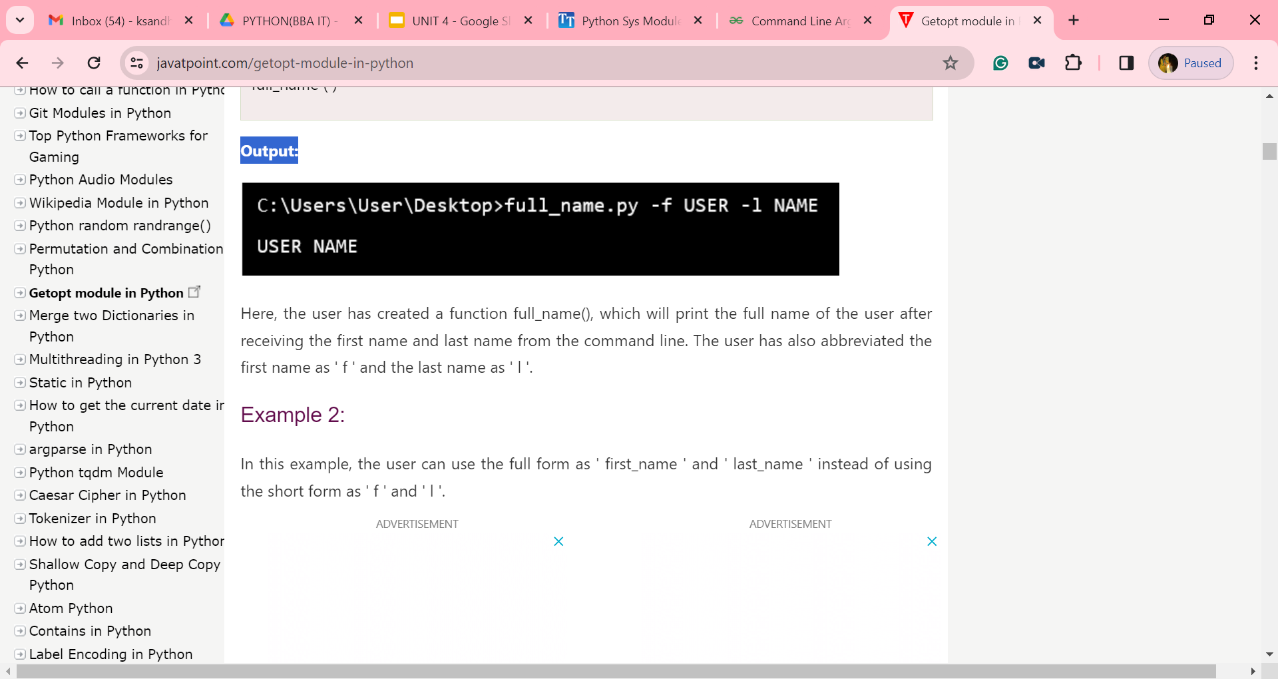
Output:

Slide 29
Using argparse module
The argparse module makes it easy to write user-friendly command-line interfaces. The program defines what arguments it requires, and argparse will figure out how to parse those out of sys.argv . The argparse module also automatically generates help and usage messages.

Slide 30
Using argparse module
import argparse
parser = argparse.ArgumentParser()
parser.add_argument("number", type=int, help="an integer number")
args = parser.parse_args()
result = args.number * 2
print("Result:", result)

Slide 31
C:\bba\python full_name.py 5
Result : 10

Slide 32
REGULAR EXPRESSIONS)
A RegEx, or Regular Expression, is a sequence of characters that forms a search pattern.
RegEx can be used to check if a string contains the specified search pattern.
RegEx Module
Python has a built-in package called re, which can be used to work with Regular Expressions.
Import the re module:
import re
RegEx in Python
When you have imported the re module, you can start using regular expressions:

Slide 33
import re
#Check if the string starts with "The" and ends with "Spain":
txt = "The Spain"
x = re.search("^The.*Spain$", txt)
if x:
print("YES! We have a match!")
else:
print("No match")

Slide 34
OUTPUT:
YES! We have a match!
Special Sequences
A special sequence is a \ followed by one of the characters in the list below, and has a special meaning:

Slide 35
Character | Description | Example
\b | Returns a match where the specified characters are at the beginning or at the end of a word (the "r" in the beginning is making sure that the string is being treated as a "raw string") | r"\bain" r"ain\b"
\B | Returns a match where the specified characters are present, but NOT at the beginning (or at the end) of a word (the "r" in the beginning is making sure that the string is being treated as a "raw string") | r"\Bain" r"ain\B"
\d | Returns a match where the string contains digits (numbers from 0-9) | "\d"
\D | Returns a match where the string DOES NOT contain digits | "\D"

Slide 36
Character | Description | Example
\s | Returns a match where the string contains a white space character | "\s"
\S | Returns a match where the string DOES NOT contain a white space character | "\S"
\w | Returns a match where the string contains any word characters (characters from a to Z, digits from 0-9, and the underscore _ character) | "\w"
\W | Returns a match where the string DOES NOT contain any word characters | "\W"

Slide 37
Metacharacters
Metacharacters are characters with a special meaning:
Character | Description | Example
[] | A set of characters | "[a-m]"
\ | Signals a special sequence (can also be used to escape special characters) | "\d"
. | Any character (except newline character) | "he..o"
^ | Starts with | "^hello"
$ | Ends with | "planet$"
* | Zero or more occurrences | "he.*o"

Slide 38
Metacharacters
Metacharacters are characters with a special meaning:
Character | Description | Example
+ | One or more occurrences | "he.+o"
? | Zero or one occurrences | "he.?o"
{} | Exactly the specified number of occurrences | "he.{2}o"
| | Either or | "falls|stays"

Slide 39
Metacharacters
Metacharacters are characters with a special meaning:
Character | Description | Example
+ | One or more occurrences | "he.+o"
? | Zero or one occurrences | "he.?o"
{} | Exactly the specified number of occurrences | "he.{2}o"
| | Either or | "falls|stays"
() | Capture and group

Slide 40
RegEx Functions
The re module offers a set of functions that allows us to search a string for a match:
Function | Description
findall | Returns a list containing all matches
search | Returns a Match object if there is a match anywhere in the string
split | Returns a list where the string has been split at each match
sub | Replaces one or many matches with a string

Slide 41
The findall() Function
The findall() function returns a list containing all matches.
import re
#Return a list containing every occurrence of "ai":
txt = "The rain in Spain"
x = re.findall("ai", txt)
print(x)
Output
['ai', 'ai']

Slide 42
The search() Function
The search() function searches the string for a match, and returns a Match object if there is a match.
If there is more than one match, only the first occurrence of the match will be returned:
import re
txt = "The rain in Spain"
x = re.search("\s", txt)
print("The first white-space character is located in position:", x.start())
Output
The first white-space character is located in position: 3

Slide 43
The split() Function
The split() function returns a list where the string has been split at each match:
import re
#Split the string at every white-space character:
txt = "The rain in Spain"
x = re.split("\s", txt)
print(x)
OUTPUT
['The', 'rain', 'in', 'Spain']

Slide 44
The sub() Function
The sub() function replaces the matches with the text of your choice:
import re
#Replace all white-space characters with the digit "9":
txt = "The rain in Spain"
x = re.sub("\s", "9", txt)
print(x)
OUTPUT
The9rain9in9Spain

Slide 45
The sub() Function
The sub() function replaces the matches with the text of your choice:
import re
#Replace all white-space characters with the digit "9":
txt = "The rain in Spain"
x = re.sub("\s", "9", txt)
print(x)
OUTPUT
The9rain9in9Spain

